Slide 1
DANISH KRONE MONEY CONVERTER PROGRESS #3
BY Virgile CRESPEL & BENJAMIN MILLE

Slide 2
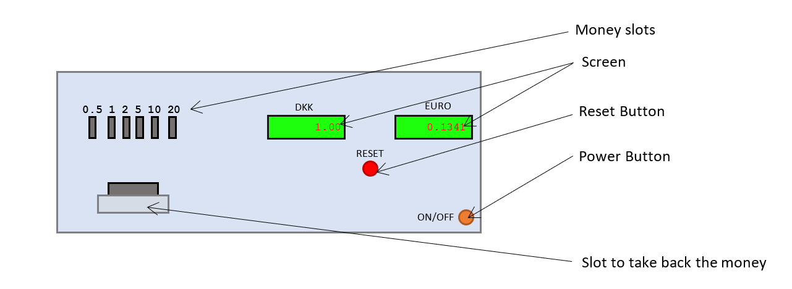

The Project :

Slide 3
Summary
SENSORS
LCD I2C LIQUID DISPLAY
WEBHOOK

Slide 4
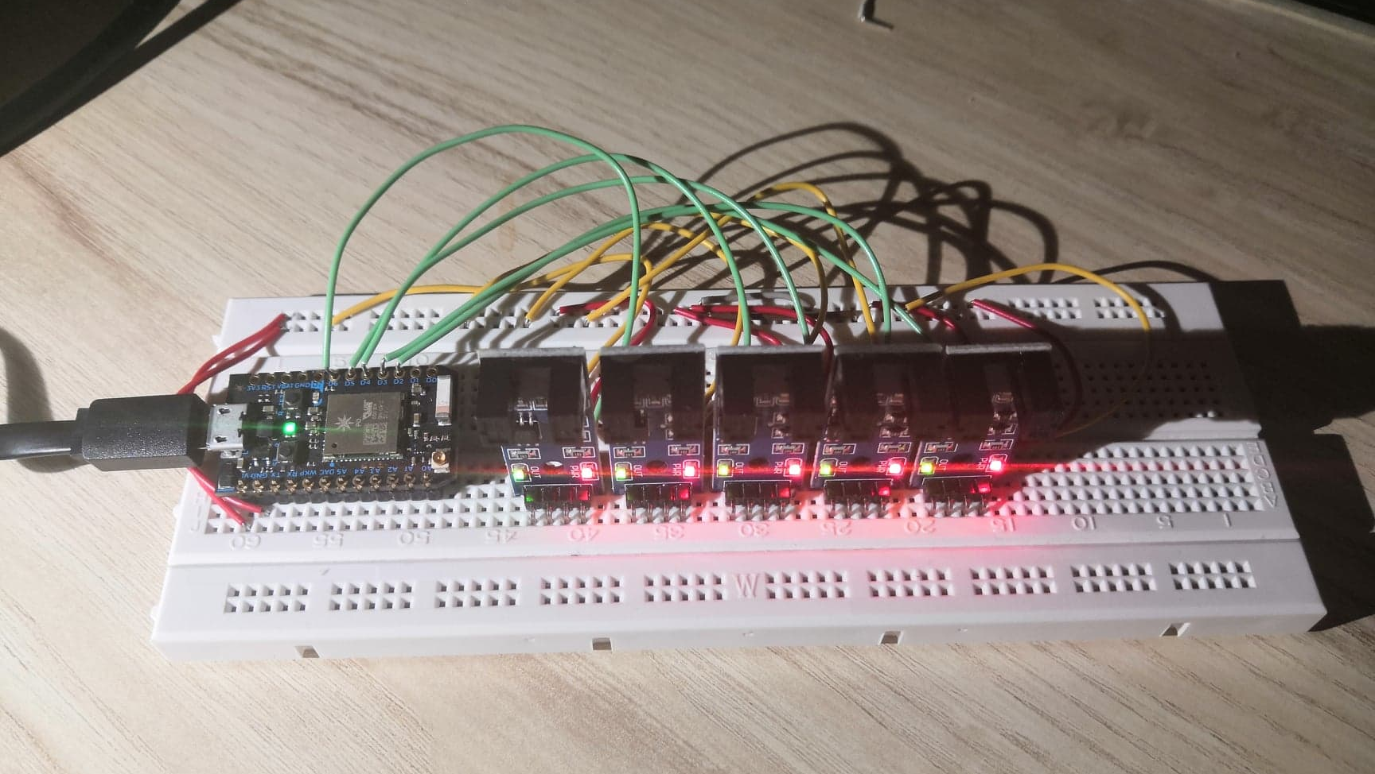
Sensors
100% Working

Slide 5
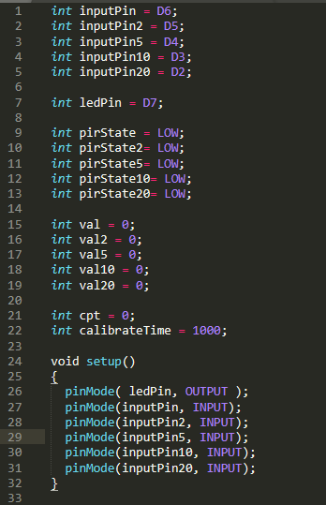
Sensors: Code (1/2)

Slide 6
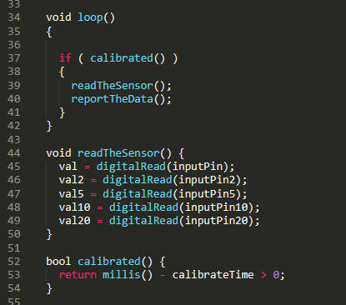
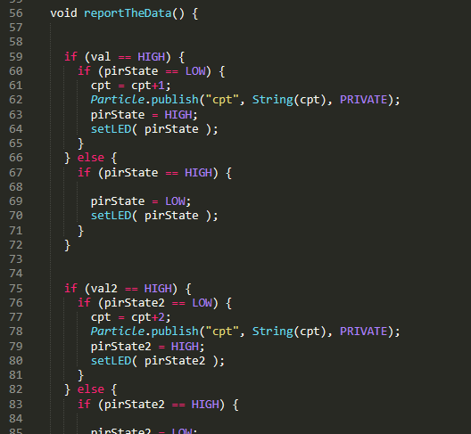
Sensors: Code (2/2)

Slide 7
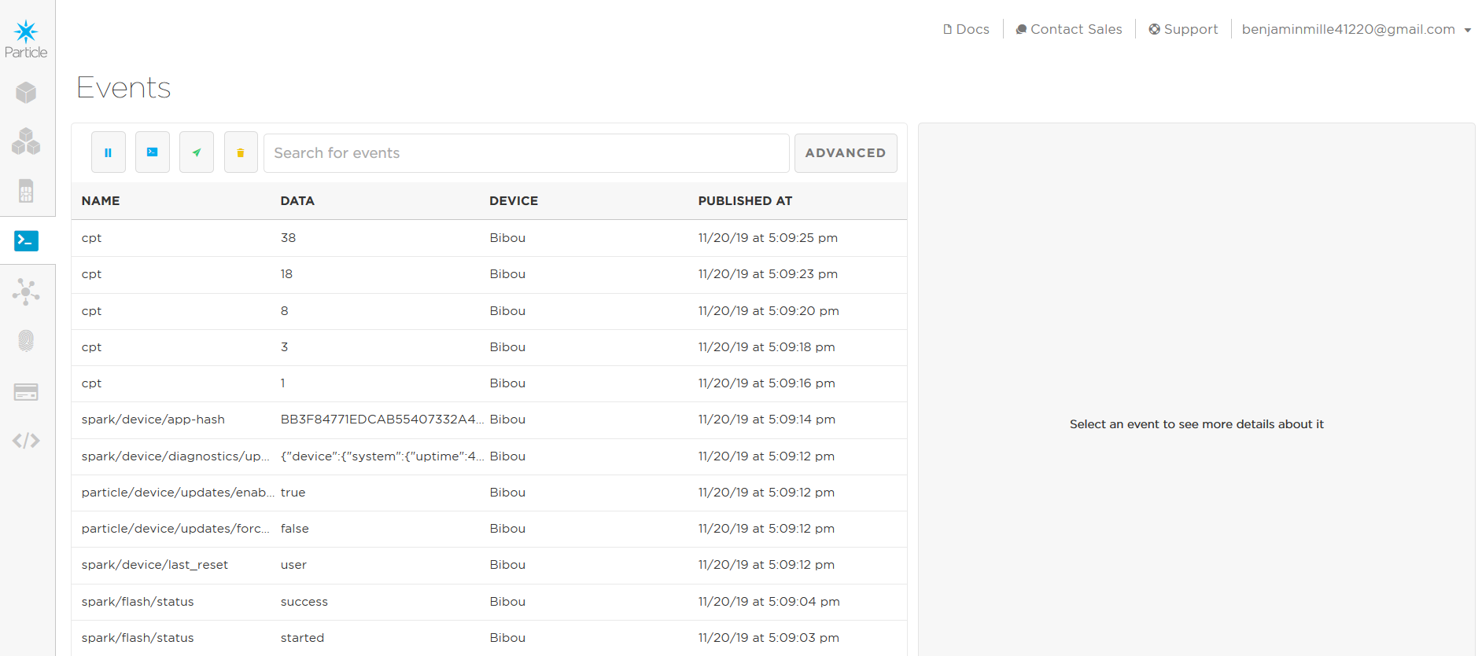
Sensors: Publishing on Web EVENTS LOG

Slide 8
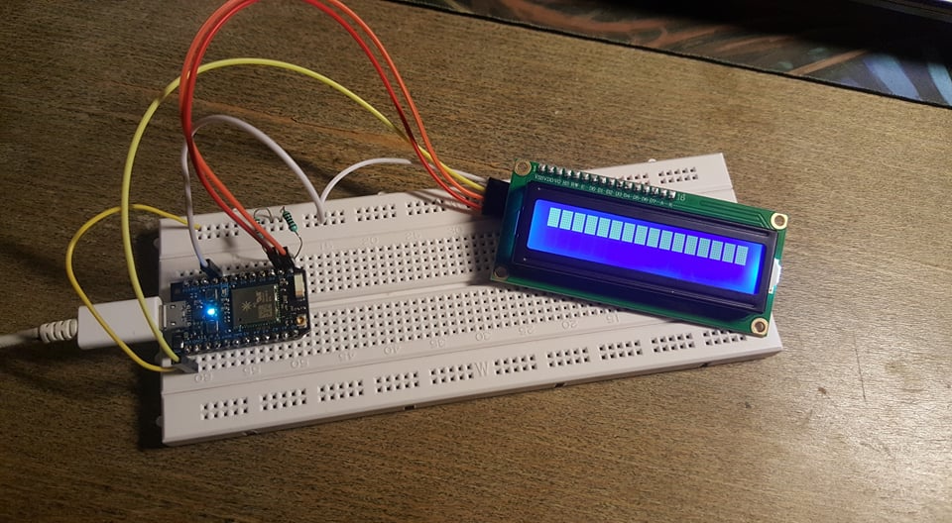
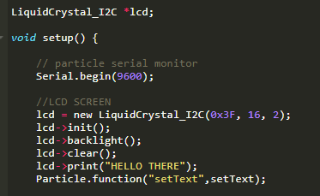
2. LCD I2C LIQUID DISPLAY
MAIN PROBLEM: The screen just shows blocks instead of the text we want.

Slide 9
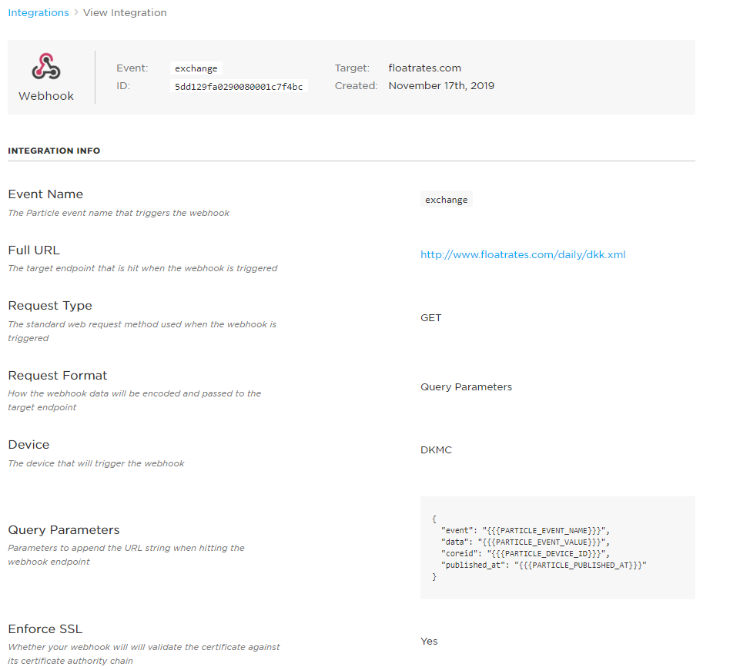
3. WEBHOOK
Is created
Use the XML file from ‘’floatrates.com’’

Slide 10
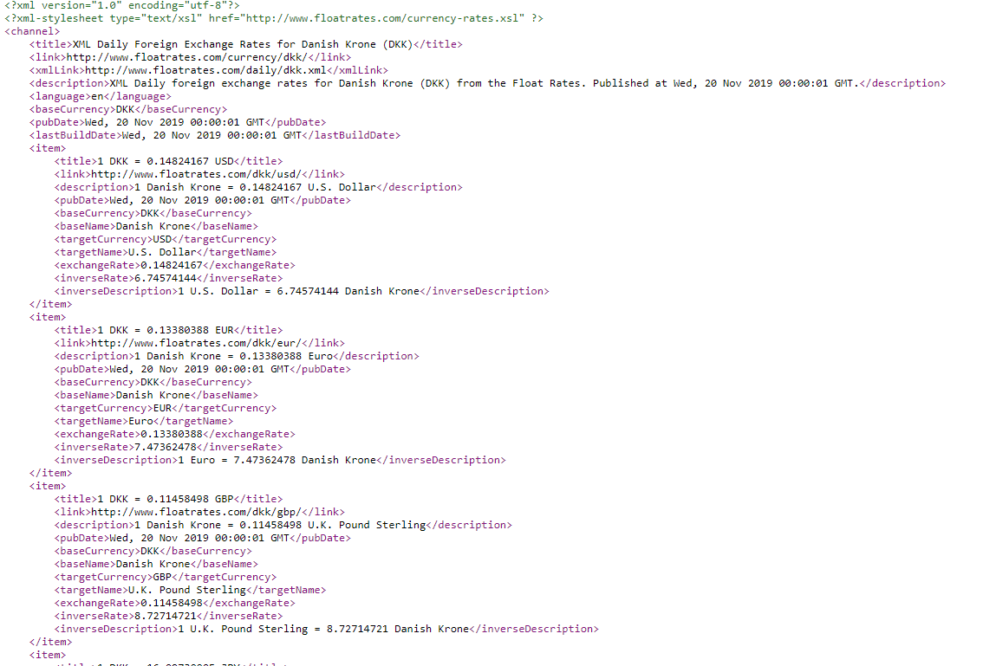
3. WEBHOOK

Slide 11
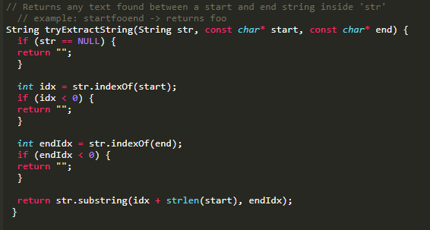
3. WEBHOOK

Slide 12
3. WEBHOOK

Slide 13
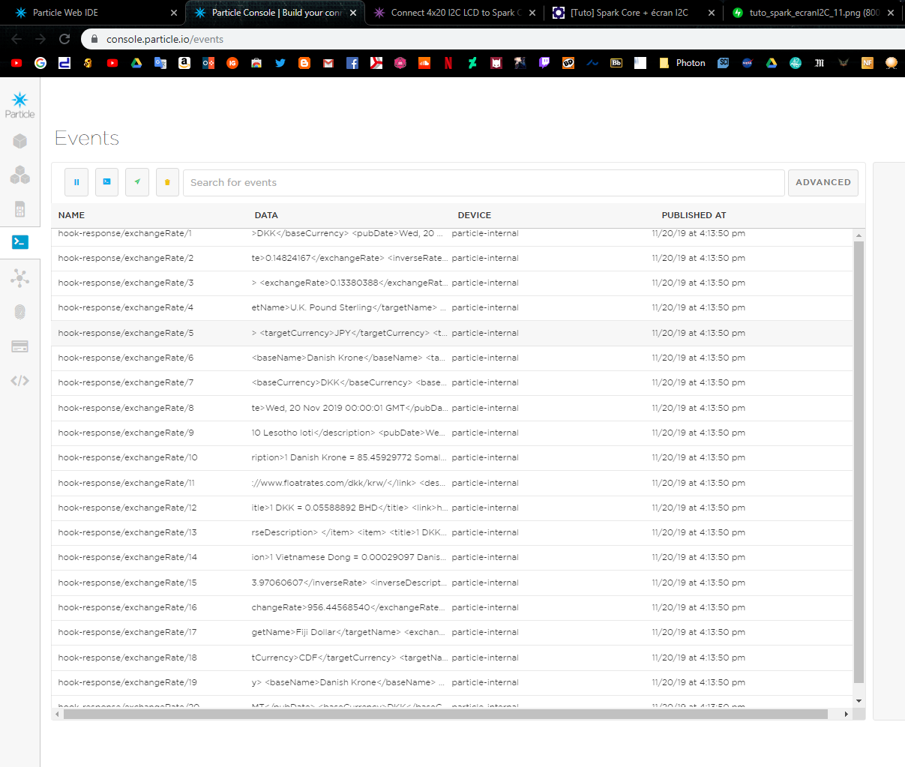
3. WEBHOOK
MAIN PROBLEM: We get every data between the first <exchange> and the last </exchange>

Slide 14
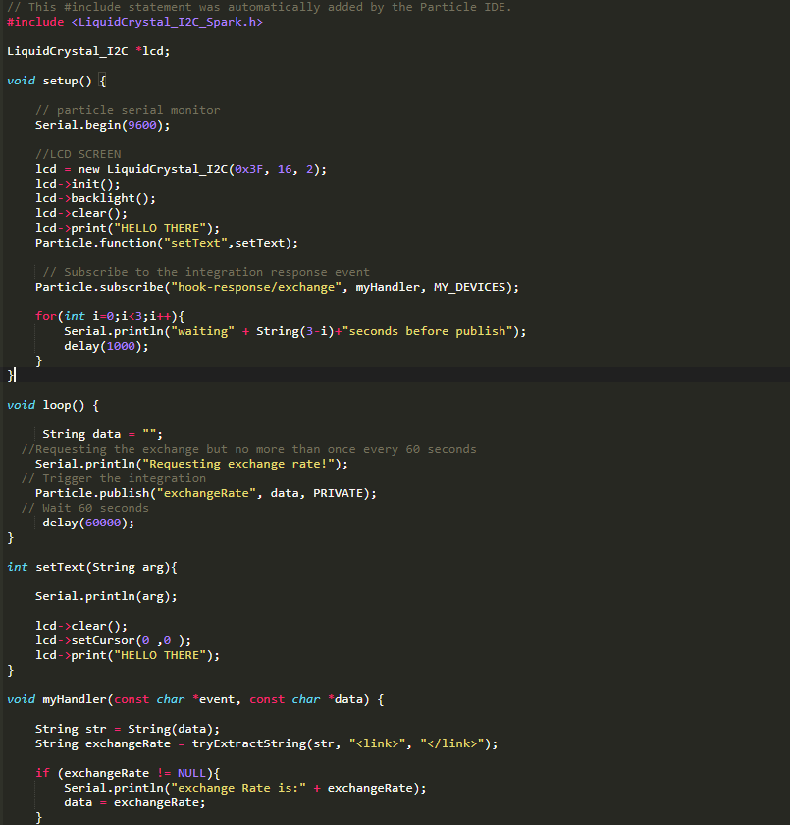
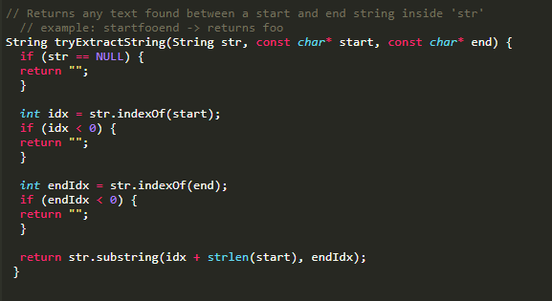
Code Index:

